Slide 1

Polygon A/S
Purpose / Vision
Goals
Features
To implement a digital system which allows customers and Polygon A/S an easy way to keep track of their buildings.
Vision 1 Customers being able to request services from Polygon A/S through the web.
Vision 2 A user-friendly and self-explanatory system.
Goal1 90% of customers should be able to use the system without prior experience.
Goal 2
A functioning system by 2/5/2016.
Feature 1 A web based building condition overview.
Feature 2
Customer checkup request by web.
Feature 3
Customer building editing and building plan upload.
Feature 4
Customer satisfaction survey.
Feature 5
Admin and employee functions that allows editing and upload of reports and pictures.

Slide 2
Polygon A/S
Product backlog
A customer can login.
A customer can get an overview of his/hers buildings.
A customer can select a building, and get additional details on that building.
In a selected building, a customer can request a check-up on that building.
Admin and employees can upload reports/pictures and edit data on buildings. (note: Admin is allowed to edit more than standard employees.)
In a selected building, a customer can edit some information on the building. (note: All data cannot be edited, as some data on building conditions are changeable by employees only.)
A customer can participate in a satisfaction survey.

Slide 3
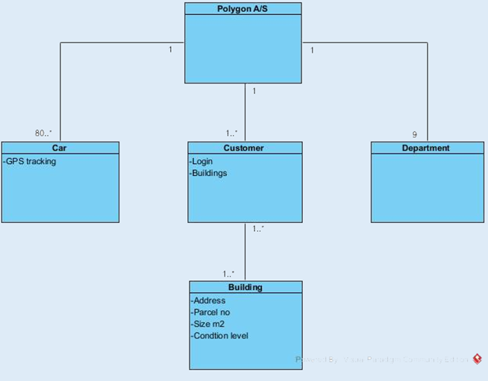
Polygon A/S
Domain model

